Slide 1
Consumer Empowerment for Embedded Software

Slide 2
Our Inspiration
1
Why Terms and Conditions are abusing consumers

Slide 3
What Inspired us
Base-level software is critical, yet the ToS is hard to understand, and alternatives non-existent.
ToSDR condenses ToS, but not for embedded software
ToS unfair because users agree to broad surveillance, right to repair

Slide 4
OUR CONCEPT
Create a website that summarizes terms of service for embedded software and promote policy reform

Slide 5
Current issues
2
Terms and Conditions are hard to read, ................. long and one sided

Slide 6
Issues with Terms of Service
Legal and technical issues require expert language
Companies' Terms of Service are complex
Consumers don't read Terms of Service
Notes:
Consumers find it hard to understand what they are agreeing to due to length and comprehension complexity

Slide 8
Grading Readability
Our criteria is the Flesch Reading Ease Score.
The score is judged based on 2 criteria.
Our website modifies the Flesch Score to create a scale from E to A
Notes:
1 average length of a sentence (measured by the number of words)
2 the average number of syllables of ever word.

Slide 9
Grading Privacy
Experts read the entire ToS.
They produce a point-form summary, grading each point
Product is given score from E to A
Notes:
1 average length of a sentence
2 the average number of syllables of word.

Slide 10
Policy Solution
3
Consumer options, sovereignty, right to repair

Slide 11
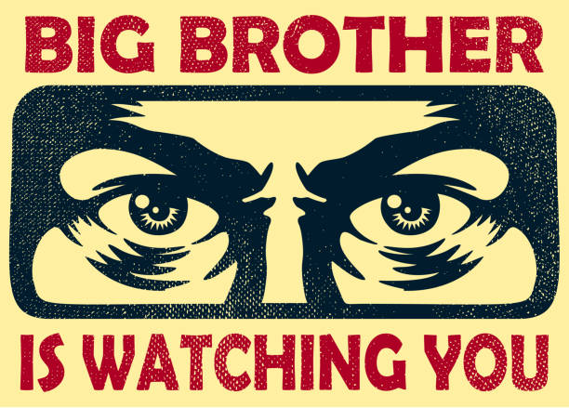
There are no Alternatives to Big Brother
If consumers want to use a product, they must consent to surveillance
Lack of alternatives undermines consent

Slide 12
Create Free Markets
Create markets that allow consumers alternative embedded software
Canadian copyright law prevents consumer tampering with software on devices
Companies don’t publish their hardware protocols to maintain monoploy on development

Slide 13
Concrete Policy
Copyright
Amend the Canadian Copyright Act
Proposed Bill C-272 is a step in the right direction
Accessibility to Developers
Require hardware manufactures to publish Hardware Abstraction Layer
Notes:
41(1)(c)

Slide 14
Thank You!

Slide 15
Bibliography
drante. 2018. Vintage Big Brother Watching You. https://www.istockphoto.com/vector/vintage-big-brother-watching-you-spying-eyes-surveillance-and-privacy-concept-vector-gm981630990-266595753.
“What Impacts The Reading Speed Of High School Students?” 2020. Iris Reading. April 16, 2020. https://irisreading.com/what-impacts-the-reading-speed-of-high-school-students/.
See additional citations in our Policy Document.

